Slide 1

The Process and Process API
(Chapter 4 & 5)
Prepared by:
Azizur Rahman Anik
Lecturer, department of CSE, UIU

Slide 2
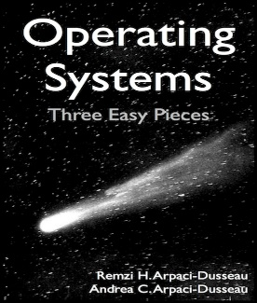
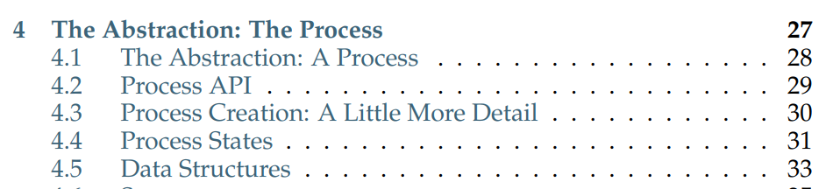
Chapter 4: The Process

Slide 3
The Process: THE CRUX OF THE PROBLEM
HOW TO PROVIDE THE ILLUSION OF MANY CPUS?
Although there are only a few physical CPUs available, how can the OS provide the illusion of a nearly-endless supply of said CPUs?
The OS creates this illusion by virtualizing the CPU
By running one process, then stopping it and running another, and so forth
Promotes the illusion that many virtual CPUs exist when in fact there is only one physical CPU (or a few)
Basic technique: Time sharing of the CPU

Slide 4
The Abstraction: A Process
A Process is simply a running program.
A Process has –
  Memory: Instructions, data lie here
  Registers
  Program counter (PC) or Instruction pointer (IP): which instruction of the program will execute next
  Stack pointer and frame pointer: manages the stack for function parameters, local variable and return addresses.
  I/O information: a list of the files the process currently has open.

Slide 5
Process API
What must be included in any interface of an operating system?
  Create: To create new process. When you type a command into the shell, or double-click on an application icon, the OS is invoked to create a new process to run the program.
  Destroy: To destroy processes forcefully (When they don’t exit by themselves)
  Wait: wait for a process to stop running.
  Miscellaneous Control: Other than killing or waiting for a process.
  Status: how long a process has run, or what state it is in.

Slide 6
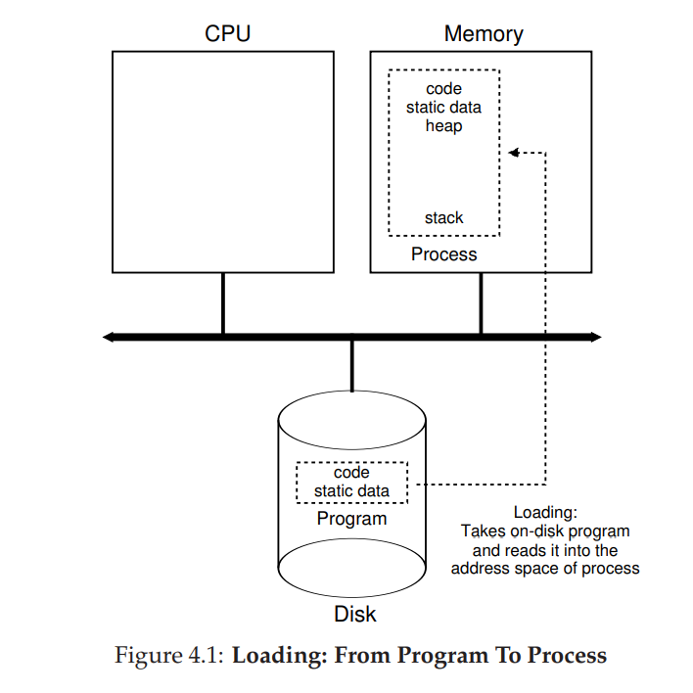
Loading From Program to Process
Programs initially resides on disk, in executable format
In early OS: the loading process is done eagerly (all at once)
In modern OS: the loading process is done lazily
Once the code and static data are loaded in memory, the OS allocates run-time stack.
Allocates memory for the program’s heap.
Some initialization tasks for I/O.

Slide 7
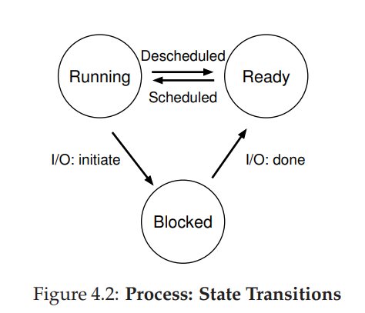
Process States
Running: A process is running on a processor. (Executing instructions)
Ready: A process is ready to run, but for some reason the OS has chosen not to run it at this given moment.
Blocked: A process has performed some kind of operating that makes it not ready to run until some other event takes place. (I/O request to disk)

Slide 8
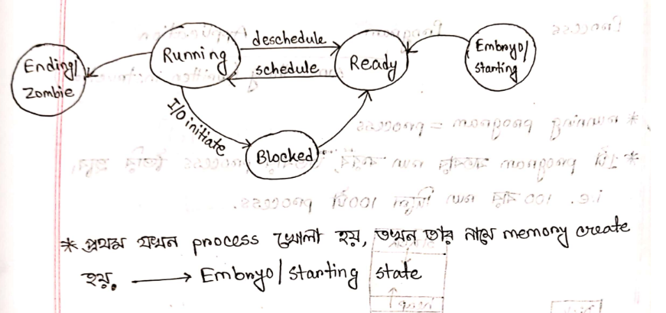
Process States
Embryo/Starting: When a program is loaded, it is in Embryo state. A memory is initialized for the process.
Ending/Zombie: When it has exited but has not yet been cleaned up. Allows other process (usually the parent that created the process) to examine the return code of the process.
Acknowledgement: This snapshot is a class note from the class of Rayhan Rashed Sir, Assistant Professor of BUET and the class note is written by Maneesha Rani Saha, a former undergraduate student of BUET

Slide 9
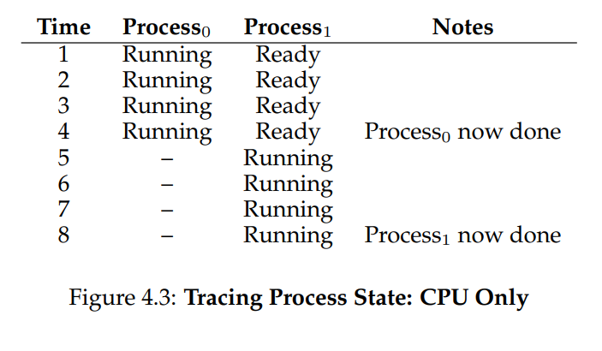
Process States

Slide 10
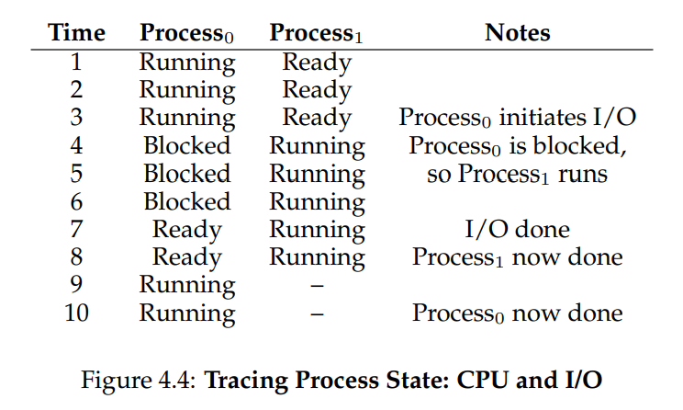
Process States

Slide 11
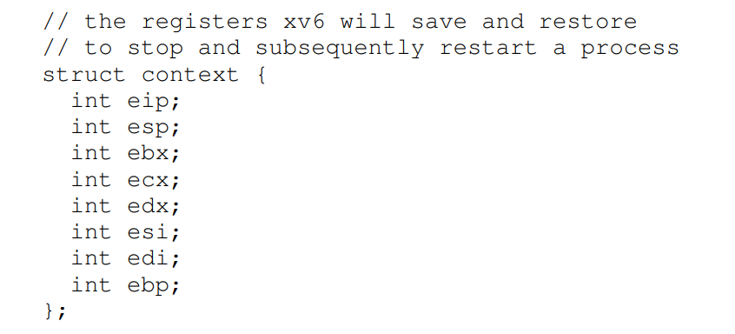
Data Structures for OS
Context Switch: When a process is stopped (not killed), its registers will be saved to this memory location. By restoring these registers ( placing their values back into the actual physical registers), the OS can resume the running process.

Slide 12
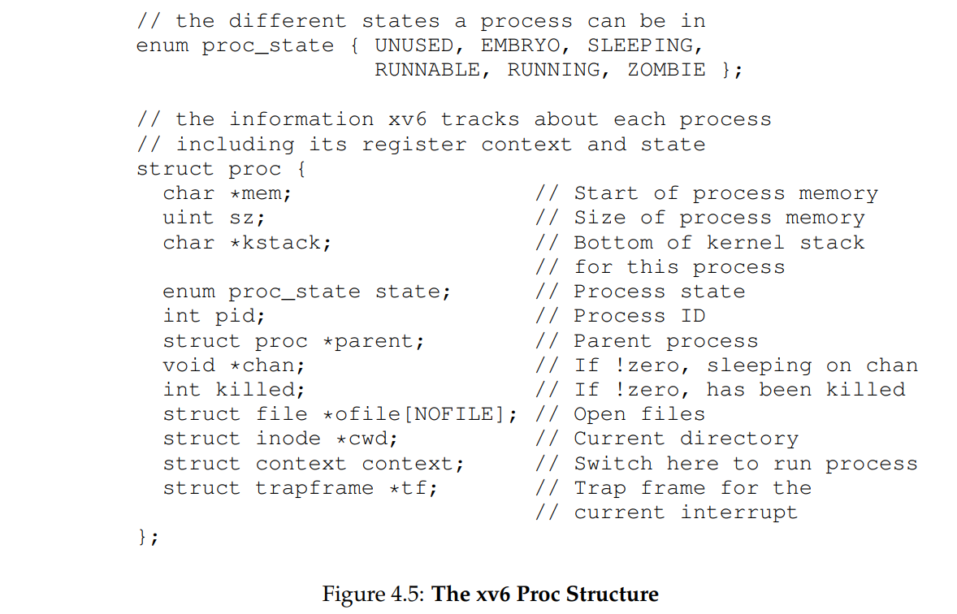
Data Structures for OS

Slide 13
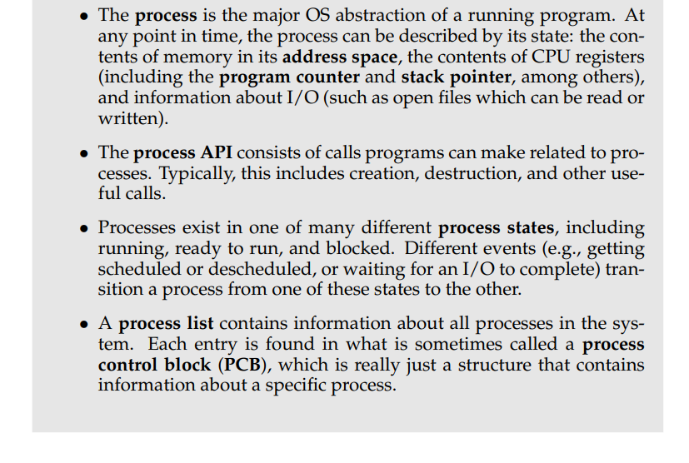
Aside: Key Process Terms

Slide 14
Some Practice Questions
What must be included in any interface of an operating system?
How a program is loaded to process?
Draw and explain the different states a process can be in any given time.
Chapter 4 ends!

Slide 15
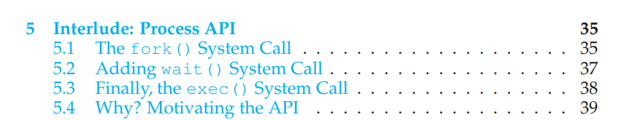
Chapter 5: Process API

Slide 16
CRUX: HOW TO CREATE AND CONTROL PROCESSES
What interfaces should the OS present for process creation and control?
How should these interfaces be designed to enable powerful functionality, ease of use, and high performance?

Slide 17
Overview of Process Creation
click on Chrome
detected by
init process
copy of init process
calls exec(chrome.exe)
fork()

Slide 18
Overview of Process Creation
click on Chrome
copy of init process has been converted to Chrome application
detected by
init process
Chrome
Chrome starts running

Slide 19
Process API: The fork() System call
To create a process, we need to request the OS through an API call
The OS provides a way to create a new process: The fork() system call.
The odd part: the process that is created is an (almost) exact copy of the calling process.
However, process id (pid), memory and file pointers are different for the newly created process through fork().

Slide 20
Let’s understand fork()
converts to
call fork(). The call is saved to stack.
the control goes to the kernel
kernel executes the fork function
An almost exact copy (Child) of the calling process (Parent) is created. Code, Stack, Heap contents are copied
int a = fork();
printf(“a = %d\n”,a);
// Parent process
// pid = 5
stack of parent
fork call is stored
int a = fork();
printf(“a = %d\n”,a);
// This is child process
// pid = 6
stack of child
fork call stored (copy from parent stack)

Slide 21
Let’s understand fork()
int a = fork();
printf(“a = %d\n”,a);
// Parent process
// pid = 5
int a = fork();
printf(“a = %d\n”,a);
// This is child process
// pid = 6
returns pid of child from the fork function
so, a <- 6
sets return value to 0 for child process during the execution of fork called from parent
so, a <- 0
what we see on terminal:
a = 6
a = 0
output:
a = 6
output:
a = 0

Slide 22
Let’s understand fork() contd.
Child Process
int main()
{
int c = fork();
if(c == 0)
{
printf(“In Child Process”);
}else if(c > 0)
{
printf(“In Parent Process”);
}
}
Parent Process
int main()
{
int c = fork();
if(c == 0)
{
printf(“In Child Process”);
}else if(c > 0)
{
printf(“In Parent Process”);
}
}
C > 0
C = 0

Slide 23
Let’s understand fork() contd.
Child Process
int main()
{
int c = fork();
if(c == 0)
{
printf(“In Child Process”);
}else if(c > 0)
{
printf(“In Parent Process”);
}
}
Parent Process
int main()
{
int c = fork();
if(c == 0)
{
printf(“In Child Process”);
}else if(c > 0)
{
printf(“In Parent Process”);
}
}
C > 0
C = 0
Output:
In Parent Process
In Child Process

Slide 24
Let’s understand Process Tree.
P
pid = 5
if( fork () || fork() ) {
printf(“True”);
else
printf(“False”);
fork-> 6
prints True
A
pid = 6
fork-> 0
fork-> 7
prints True
// Process A
if( fork () || fork() ) {
printf(“True”);
else
printf(“False”);
// Process B
if( fork () || fork() ) {
printf(“True”);
else
printf(“False”);
B
pid = 7
fork -> 0 (copy from A)
fork-> 0
prints False

Slide 25
Let’s understand Process Tree.
if( fork () && fork() ) {
printf(“True”);
else
printf(“False”);
fork1-> 6
fork2-> 7
P
pid = 5
prints True
A
pid = 6
fork1-> 0
B
pid = 7
fork1-> 6 (Copy from P)
fork2 -> 0
prints False
// Process A
if( fork () && fork() ) {
printf(“True”);
else
printf(“False”);
// Process B
if( fork () && fork() ) {
printf(“True”);
else
printf(“False”);
prints False

Slide 26
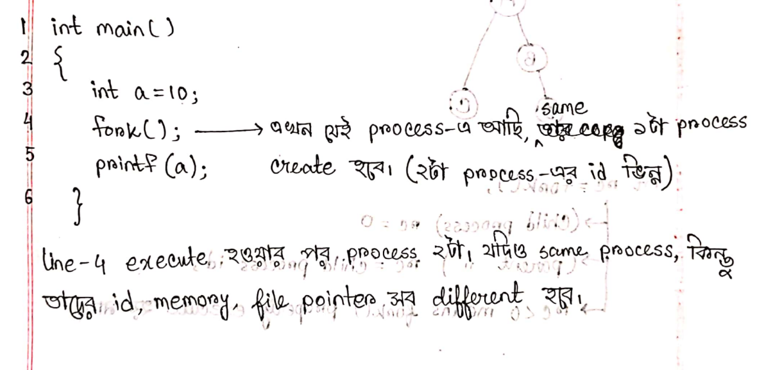
Let’s understand fork()
Acknowledgement: This snapshot is a class note from the class of Rayhan Rashed Sir, Assistant Professor of BUET and the class note is written by Maneesha Rani Saha, a former undergraduate student of BUET

Slide 27
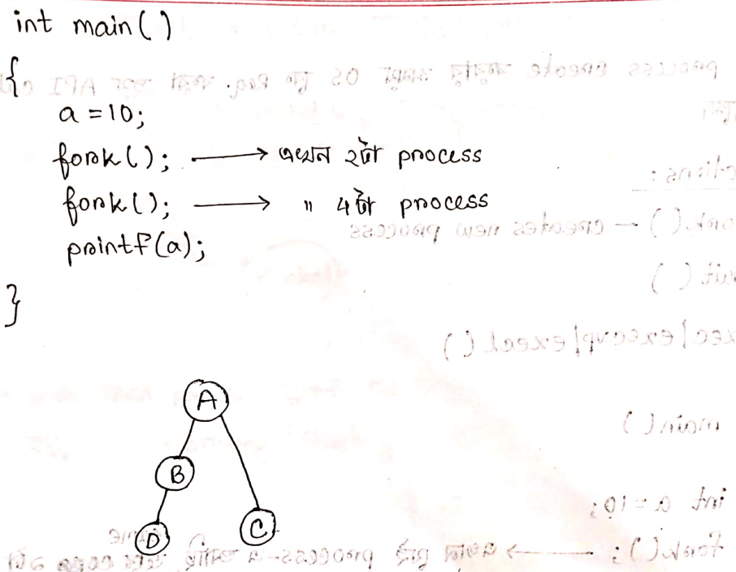
Let’s understand fork()
Acknowledgement: This snapshot is a class note from the class of Rayhan Rashed Sir, Assistant Professor of BUET and the class note is written by Maneesha Rani Saha, a former undergraduate student of BUET

Slide 28
Let’s understand fork()
int rc = fork();
For child process, rc = 0
For parent process, rc = process id of child
rc < 0 means the fork() is not executed properly.

Slide 29
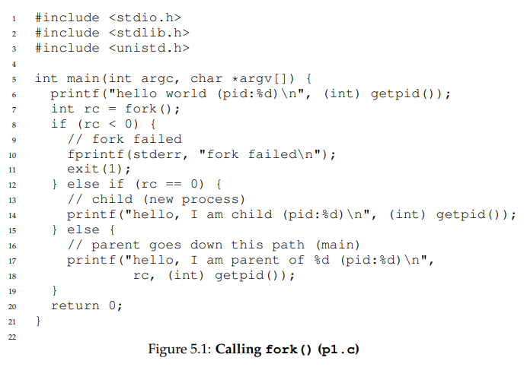
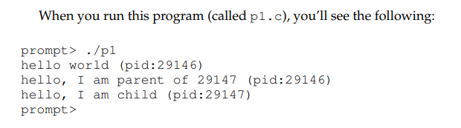
Let’s understand fork()

Slide 30
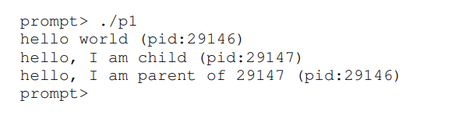
Let’s understand fork()
the output (of p1.c) is not deterministic.
When the child process is created, there are now two active processes in the system that we care about: the parent and the child.
Assuming we are running on a system with a single CPU (for simplicity), then either the child or the parent might run at that point.

Slide 31
The wait() System call
Sometimes , it is quite useful for a parent to wait for a child process to finish what it has been doing
This task is accomplished by the wait() system call.
The parent process calls wait() to delay its execution until the child process finish executing.
Makes the output deterministic.
Child process has nothing to do with the wait() system call!

Slide 32
The wait() System call (newly added)
wait(NULL) -> this waits for a single child. If a parent process has 4 children but it calls wait(NULL) for a single time, then after the completion of any one child, the parent process will be able to run.
waitpid(int child_id) -> waits for the specified child. If some other child completes execution before the specified child, then the parent will not be able to run.
If the parent has 4 children and needs to wait for all the children, then it needs to call wait(NULL) for 4 times.

Slide 33
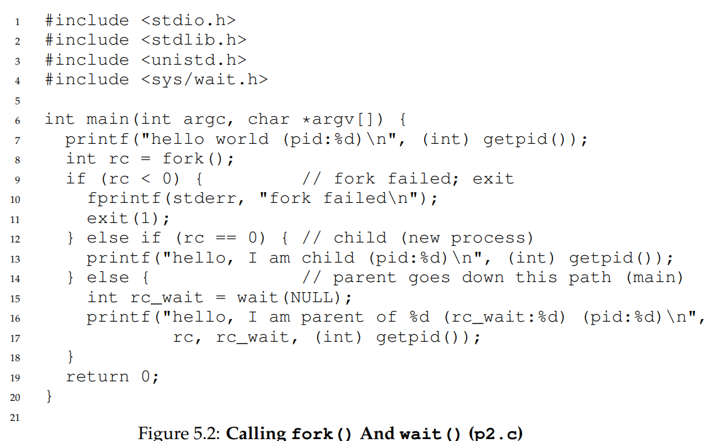
The wait() System call

Slide 34
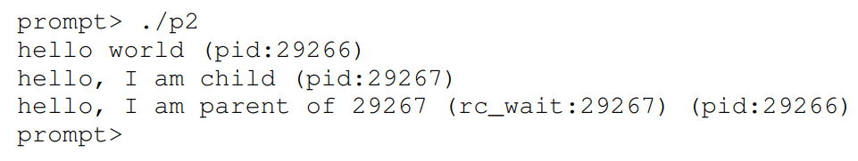
The wait() System call
Output of the previous code

Slide 35
The wait() System call
With this code, we now know that the child will always print first.
Why do we know that?
Well, it might simply run first, as before, and thus print before the parent.
However, if the parent does happen to run first, it will immediately call wait(); this system call won’t return until the child has run and exited .
Thus, even when the parent runs first, it politely waits for the child to finish running, then wait() returns, and then the parent prints its message.

Slide 36
The exec() System call
A final and important piece of the process creation API is the exec() system call3 .
This system call is useful when you want to run a program that is different from the calling program
Transforms the running program(child process) to a completely different program.
Overwrites the code segment of the running process with a new process (passed as argument to the exec() system call. Heap, stack & other parts of the memory space of the program are re-initialized.

Slide 37
The exec() System call
int main()
{
if(fork() == 0)
{ //in child process
exec(“ls”); //the child process will be transformed to “ls” program
}
else
{ //parent
}
}

Slide 38
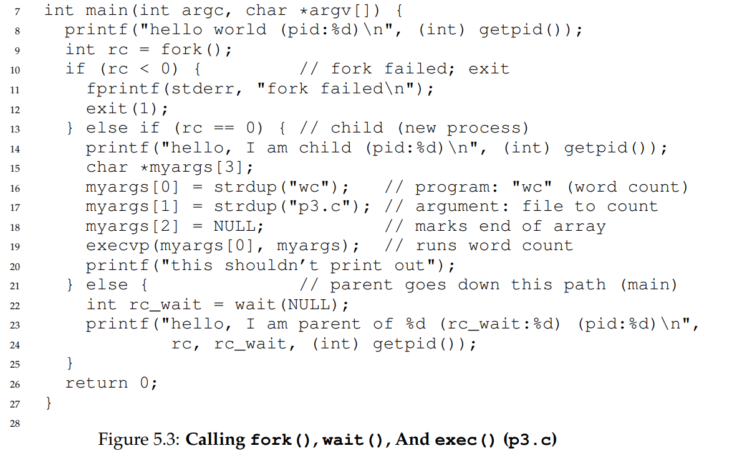
The exec() System call

Slide 39
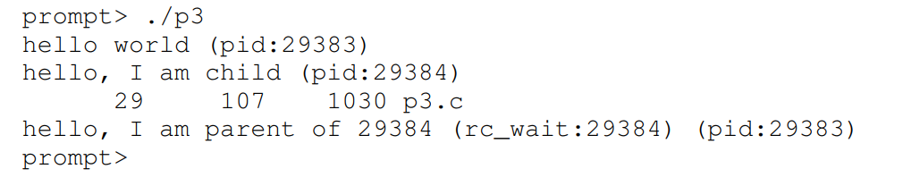
The exec() System call
given the name of an executable (e.g., wc), and some arguments (e.g., p3.c)
it loads code (and static data) from that executable and overwrites its current code segment (and current static data) with it
the heap and stack and other parts of the memory space of the program are re-initialized.
Then the OS simply runs that program, passing in any arguments as the argv of that process.
Thus, it does not create a new process; rather, it transforms the currently running program (formerly p3) into a different running program (wc).
After the exec() in the child, it is almost as if p3.c never ran; a successful call to exec() never returns.

Slide 40
Why? Motivating the API
The separation of fork() and exec() makes the pipeline easier.
Allows to do some initialization before calling the exec() system call.
An example:
  The shell is just a user program.
  It shows us a prompt and waits for us to type something into it.
  When we type a command (name of an executable program), it figures out where in the file system the executable resides,
  Then it calls fork() to create a child process to run the command.
  Calls some variant of exec to run the command.
  Waits for the command to complete by calling wait().
  When the child completes, the shell returns from wait() and prints out a prompt again

Slide 41
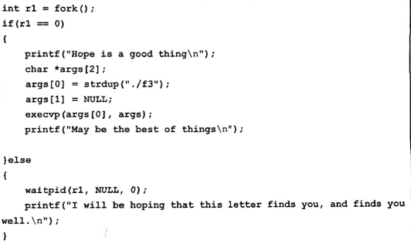
Combining Everything…
Parent
Create Child Process
Child
parent waits for child

Slide 42

Combining Everything…
Child in execution
f3 file (not a process)

Slide 43
Combining Everything…
Child in execution
f3 file (not a process)
Hope is a good thing

Slide 44
Combining Everything…
Child in execution
f3 file (not a process)
child will be converted to f3

Slide 45
Combining Everything…
Child in execution
f3 file (not a process)
this is the child process now. Existence of previous child process is gone!
No good thing ever dies.

Slide 46
Combining Everything…
Parent
Parent process returns from wait and prints:
I will be hoping that this letter finds you, and finds you well.

Slide 47
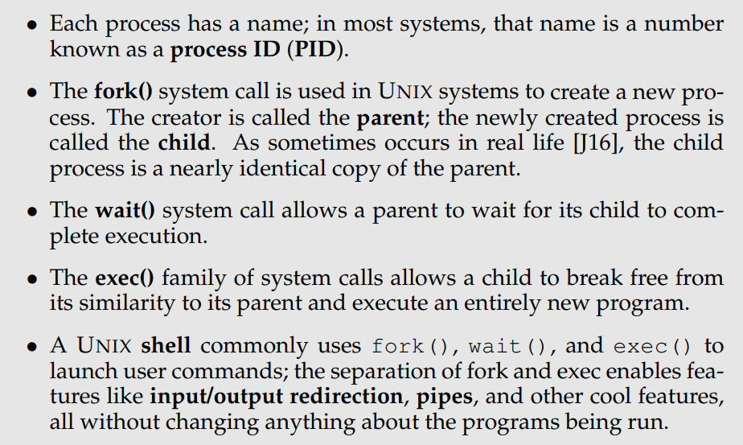
Aside: Key Process API Terms

Slide 48
Some Practice Questions
What is the purpose of fork(), wait() and exec() system calls?
How does the exec() system call transforms the running process to a completely different program?
What flexibility does the separation of wait() and exec() system call provide? Explain with an example.
What will be the output of the following code? [some codes will be uploaded in the eLms for practice]

Slide 49
End of Chapter 5
Thank you!

